Slide 1
Lecture 6: Dimensionality Reduction
CMSC5741 Big Data Tech. & Apps.
Prof. Michael R. Lyu
Computer Science & Engineering Dept.
The Chinese University of Hong Kong

Slide 2
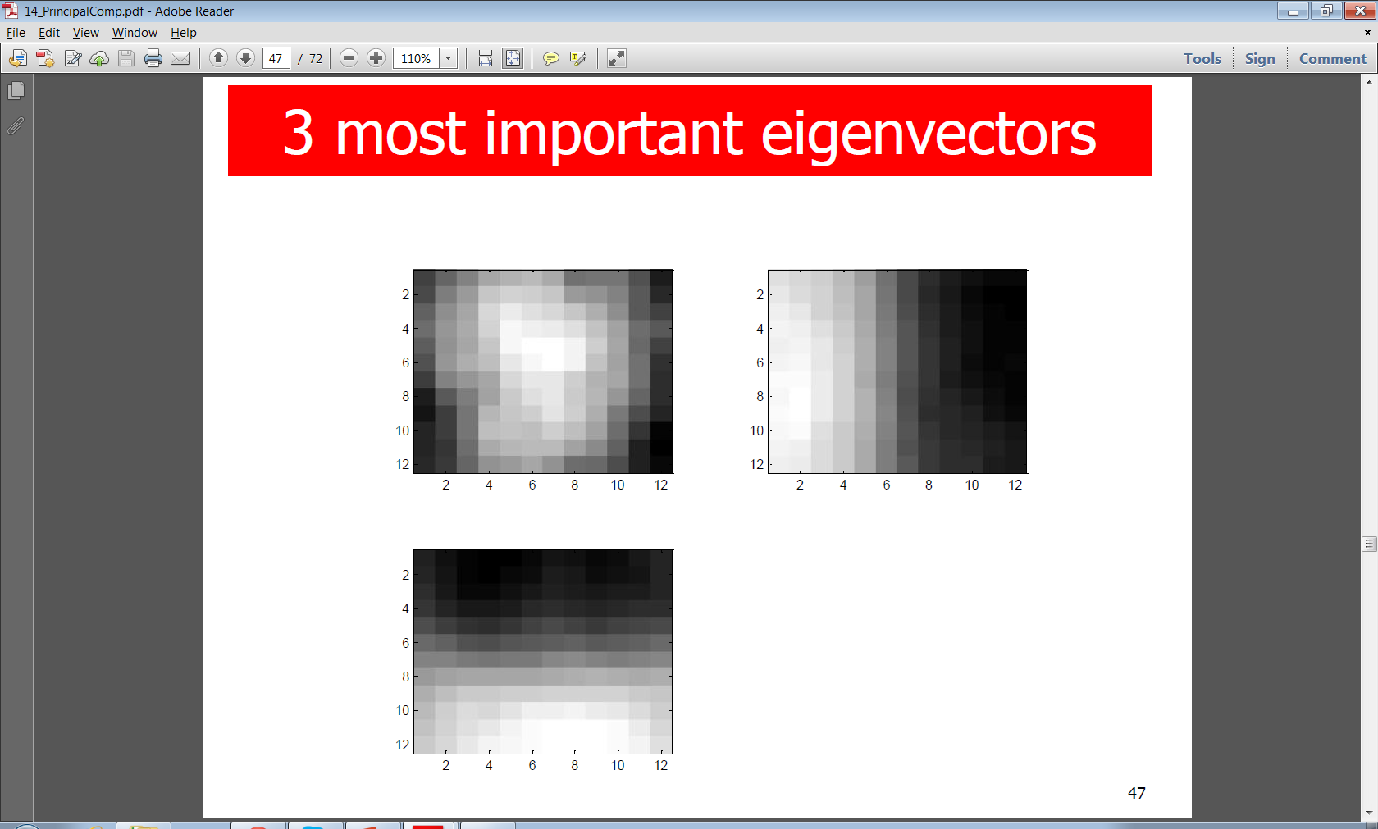
A Compression Example
Question: Can we reduce a high-dimension data by a factor of 50 without losing too much accuracy?
Answer: Yes, we can!
144D-vector representation to 3D-vector.
Notes:
Reduction of 144D-vector representation to 3D-vector.

Slide 3
Outline
Motivation
SVD
CUR
Application of SVD and CUR
PCA
Extension to robust PCA

Slide 4
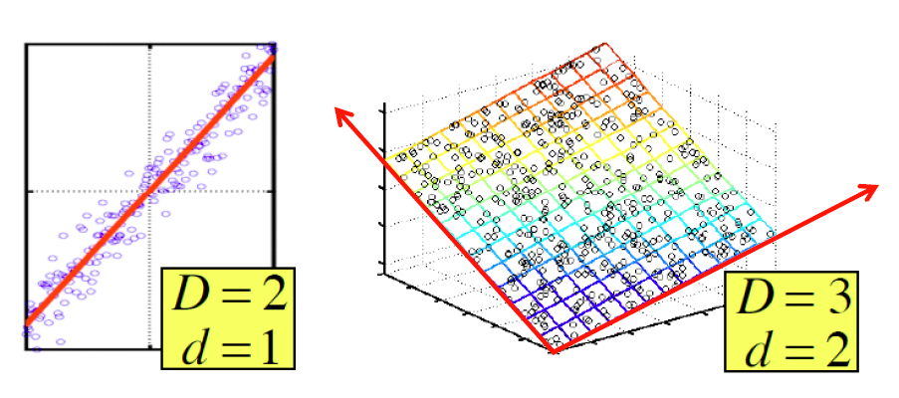
Dimensionality Reduction Motivation
Assumption: Data lie on or near a low d-dimensional subspace
Axes of this subspace are effective representation of the data

Slide 5
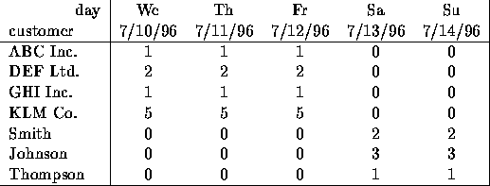
Dimensionality Reduction Motivation
Compress / reduce dimensionality:
10⁶ rows; 10³ columns; no updates
Random access to any cell(s); small error: OK
16
16
16
16
16
The above matrix is really “2-dimensional.” All rows can be reconstructed by scaling [1 1 1 0 0] or [0 0 0 1 1]

Slide 6
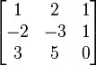
Rank of a Matrix
Q: What is rank of a matrix A?
A: No. of linearly independent rows/columns of A
For example:
Matrix A = has rank r=2
Why? The first two rows are linearly independent, so the rank is at least 2, but all three rows are linearly dependent (the first is equal to the sum of the second and third) so the rank must be less than 3.
Why do we care about low rank?
We can write A as two “basis” vectors: [1 2 1] [-2 -3 1]
And new coordinates of : [1 0] [0 1] [1 -1]

Slide 7
Rank is “Dimensionality”
Cloud of points 3D space:
Think of point positions as a matrix:
We can rewrite coordinates more efficiently!
Old basis vectors: [1 0 0] [0 1 0] [0 0 1]
New basis vectors: [1 2 1] [-2 -3 1]
Then A has new coordinates: [1 0]. B: [0 1], C: [1 -1]
Notice: We reduced the number of coordinates!
A
B
C
A
1 row per point:

Slide 8
Dimensionality Reduction
Goal of dimensionality reduction is to discover the axis of data!
Rather than representing every point with 2 coordinates we represent each point with
1 coordinate (corresponding to the position of the point on the red line).
By doing this we incur a bit of error as the points do not exactly lie on the line

Slide 9
Why Reduce Dimensions?
Why reduce dimensions?
Discover hidden correlations/topics
Words that occur commonly together
Remove redundant and noisy features
Not all words are useful
Interpretation and visualization
Easier storage and processing of the data

Slide 10
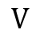
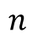
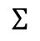
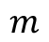
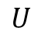
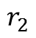
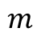
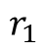

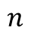
SVD: Dimensionality Reduction
$$U$$
$$Σ$$
$$V$$
B
$$n$$
$$m$$
$$≈$$
$$m$$
$$n$$
$$r_{1}$$
$$r_{2}$$

Slide 11
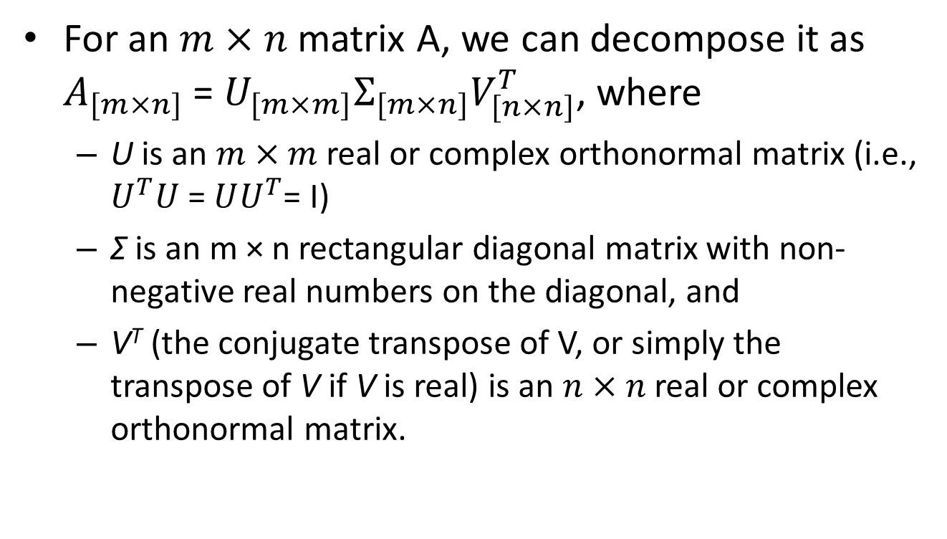
SVD: Singular Value Decomposition
For an $m×n$ matrix A, we can decompose it as $A_{[m×n]}$ = $U_{[m×m]}Σ_{[m×n]}V_{[n×n]}^{T}$, where
U is an $m×m$real or complex orthonormal matrix (i.e., $U_{}^{T}U$ = $UU_{}^{T}$= I)
Σ is an m × n rectangular diagonal matrix with non-negative real numbers on the diagonal, and
V^{T} (the conjugate transpose of V, or simply the transpose of V if V is real) is an $n×n$real or complex orthonormal matrix.

Slide 12
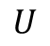
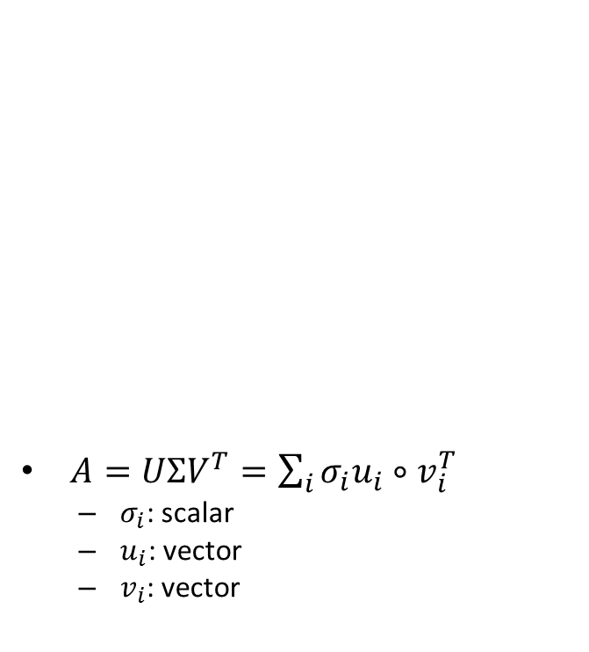
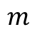
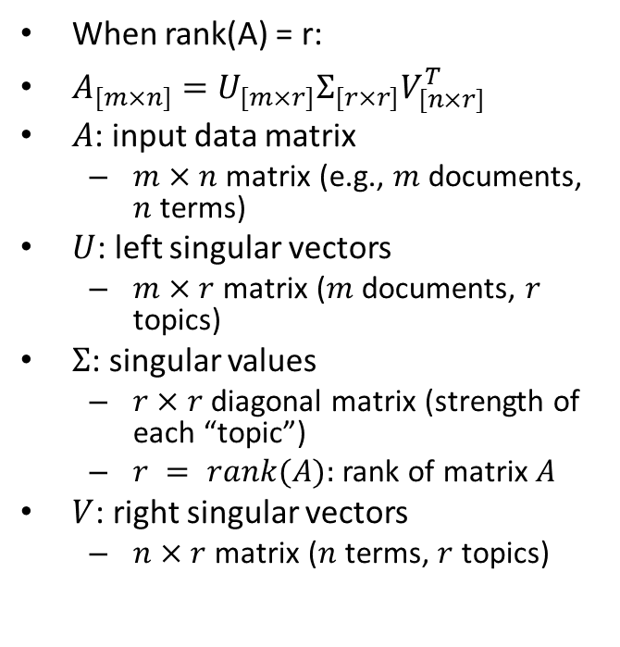
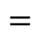
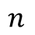
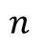
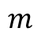
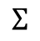
SVD: Singular Value Decomposition
$$U$$
$$Σ$$
𝑉^{𝑇}
When rank(A) = r:
$A_{[m×n]}=U_{[m×r]}Σ_{[r×r]}V_{[n×r]}^{T}$
$A$: input data matrix
$m×n$matrix (e.g., $m$ documents, $n$ terms)
$U$: left singular vectors
$m×r$ matrix ($m$documents, $r$ topics)
$Σ$: singular values
$r×r$ diagonal matrix (strength of each “topic”)
$r = rank(A):$rank of matrix$A$
$V$: right singular vectors
$n×r$ matrix ($n$ terms, $r$ topics)
$A=UΣV^{T}=\sum_{i}{σ_{i}u_{i}∘v_{i}^{T}}$
$σ_{i}$: scalar
$u_{i}$: vector
$v_{i}$: vector
A
$$n$$
$$m$$
$$=$$
$$m$$
$$n$$

Slide 13
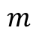
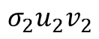
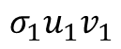
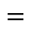
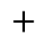
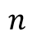
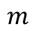
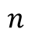
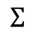
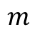
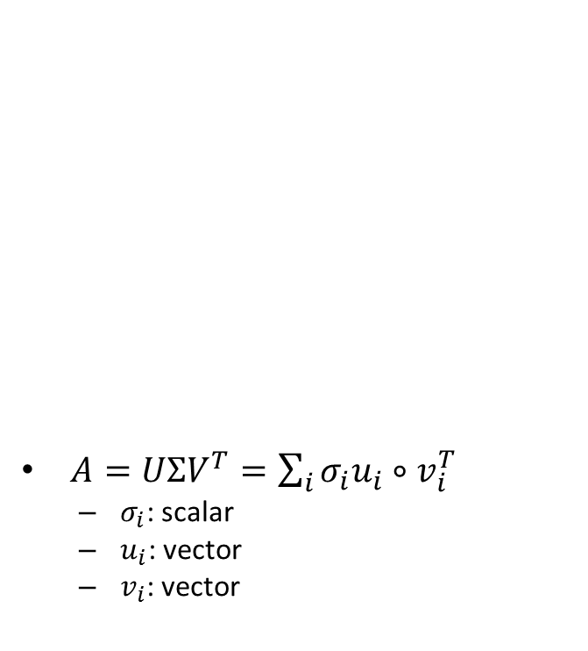
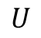
SVD: Singular Value Decomposition
$$U$$
$$σ_{1}u_{1}v_{1}$$
$$Σ$$
𝑉^{𝑇}
$A=UΣV^{T}=\sum_{i}{σ_{i}u_{i}∘v_{i}^{T}}$
$σ_{i}$: scalar
$u_{i}$: vector
$v_{i}$: vector
A
A
$$n$$
$$n$$
$$m$$
$$=$$
$$m$$
$$m$$
$$=$$
$$m$$
$$n$$
$$n$$
$$σ_{2}u_{2}v_{2}$$
$$+$$

Slide 14
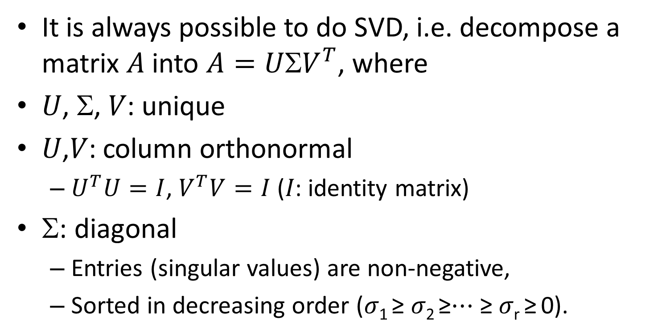
SVD Properties
It is always possible to do SVD, i.e. decompose a matrix 𝐴 into $A=UV^{T}$, where
𝑈, Σ, 𝑉: unique
𝑈,𝑉: column orthonormal
$U^{T}U=I$, $V^{T}V=I$ (𝐼: identity matrix)
Σ: diagonal
Entries (singular values) are non-negative,
Sorted in decreasing order (𝜎₁ ≥ 𝜎₂ ≥⋯ ≥ 𝜎_{r} ≥ 0).

Slide 15
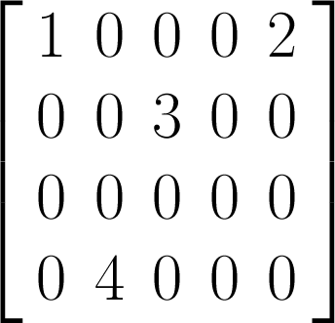
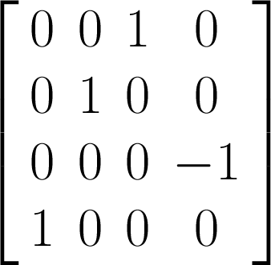
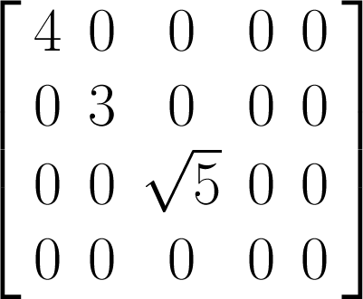
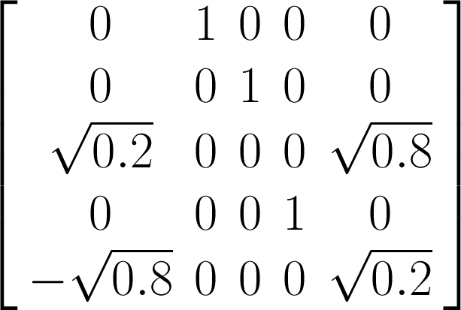


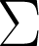
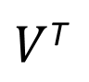
SVD Example
We give an example of a simple SVD decomposition
=
$V$^{T}

Slide 16
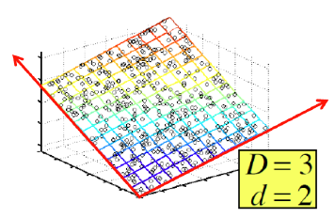
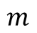
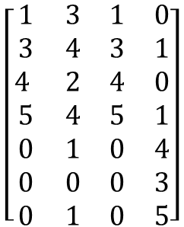
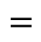
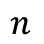
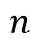
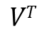
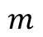



SVD: Example – Users-to-Movies
$A=UΣV^{T}$- example: Users to Movies
The Avengers
Star Wars
Matrix
Twilight
$$U$$
$$Σ$$
$$VT$$
$$\left[\begin{matrix}1 & 3 & 1 & 0 \\ 3 & 4 & 3 & 1 \\ 4 & 2 & 4 & 0 \\ 5 & 4 & 5 & 1 \\ 0 & 1 & 0 & 4 \\ 0 & 0 & 0 & 3 \\ 0 & 1 & 0 & 5\end{matrix}\right]$$
SciFi
$$n$$
$$m$$
$$=$$
$$m$$
Romance
$$n$$
“topics” or “concepts”
aka. Latent dimensions
aka. Latent factors
Notes:
In this example, there are two “concepts” underlying the movies: science fiction and romance.

Slide 17










SVD: Example – Users-to-Movies
$A=UΣV^{T}$- example
The Avengers
Star Wars
Matrix
SciFi-concept
Twilight
Romance-concept
$$\left[\begin{matrix}1 & 3 & 1 & 0 \\ 3 & 4 & 3 & 1 \\ 4 & 2 & 4 & 0 \\ 5 & 4 & 5 & 1 \\ 0 & 1 & 0 & 4 \\ 0 & 0 & 0 & 3 \\ 0 & 1 & 0 & 5\end{matrix}\right]$$
$$\left[\begin{matrix}0.24 & 0.02 & 0.69 \\ 0.48 & −0.02 & 0.43 \\ 0.49 & −0.08 & −0.52 \\ 0.68 & −0.07 & −0.16 \\ 0.06 & 0.57 & 0.06 \\ 0.01 & 0.41 & −0.20 \\ 0. 07 & 0.70 & −0.01\end{matrix}\right]$$
SciFi
$$\left[\begin{matrix}11.9 & 0 & 0 \\ 0 & 7.1 & 0 \\ 0 & 0 & 2.5\end{matrix}\right]$$
$$m$$
X
X
$$m$$
$$=$$
Romance
$$\left[\begin{matrix}0.59 & 0.54 & 0.59 & 0. 05 \\ −0.10 & 0.12 & −0.10 & 0.98 \\ −0. 37 & 0.83 & −0.37 & −0.17\end{matrix}\right]$$
$$n$$
$$n$$
Notes:
The rows of M as people and the columns of M as movies.

Slide 18
SVD: Example – Users-to-Movies
$A=UΣV^{T}$- example
U is “user-to-concept” similarity matrix
The Avengers
Star Wars
Matrix
Twilight
SciFi-concept
Romance-concept
$$\left[\begin{matrix}1 & 3 & 1 & 0 \\ 3 & 4 & 3 & 1 \\ 4 & 2 & 4 & 0 \\ 5 & 4 & 5 & 1 \\ 0 & 1 & 0 & 4 \\ 0 & 0 & 0 & 3 \\ 0 & 1 & 0 & 5\end{matrix}\right]$$
$$\left[\begin{matrix}0.24 & 0.02 & 0.69 \\ 0.48 & −0.02 & 0.43 \\ 0.49 & −0.08 & −0.52 \\ 0.68 & −0.07 & −0.16 \\ 0.06 & 0.57 & 0.06 \\ 0.01 & 0.41 & −0.20 \\ 0. 07 & 0.70 & −0.01\end{matrix}\right]$$
SciFi
$$\left[\begin{matrix}11.9 & 0 & 0 \\ 0 & 7.1 & 0 \\ 0 & 0 & 2.5\end{matrix}\right]$$
$$m$$
X
X
$$m$$
$$=$$
Romance
$$\left[\begin{matrix}0.59 & 0.54 & 0.59 & 0. 05 \\ −0.10 & 0.12 & −0.10 & 0.98 \\ −0. 37 & 0.83 & −0.37 & −0.17\end{matrix}\right]$$
$$n$$
$$n$$
Notes:
The rows of M as people and the columns of M as movies.
The matrix U connects user to concepts.
The value 0.24 in the first row and first column of U is smaller than some of the other entries in that column, because the first person watches only science fiction, he does not rate those movies highly. The second column of the first row of U is nearly zero, because he does not rate romance movies at all.

Slide 19
SVD: Example – Users-to-Movies
$A=UΣV^{T}$- example
The Avengers
Star Wars
Matrix
Twilight
SciFi-concept
“strength” of the SciFi-concept
$$\left[\begin{matrix}1 & 3 & 1 & 0 \\ 3 & 4 & 3 & 1 \\ 4 & 2 & 4 & 0 \\ 5 & 4 & 5 & 1 \\ 0 & 1 & 0 & 4 \\ 0 & 0 & 0 & 3 \\ 0 & 1 & 0 & 5\end{matrix}\right]$$
$$\left[\begin{matrix}0.24 & 0.02 & 0.69 \\ 0.48 & −0.02 & 0.43 \\ 0.49 & −0.08 & −0.52 \\ 0.68 & −0.07 & −0.16 \\ 0.06 & 0.57 & 0.06 \\ 0.01 & 0.41 & −0.20 \\ 0. 07 & 0.70 & −0.01\end{matrix}\right]$$
SciFi
$$\left[\begin{matrix}11.9 & 0 & 0 \\ 0 & 7.1 & 0 \\ 0 & 0 & 2.5\end{matrix}\right]$$
$$m$$
X
X
$$m$$
$$=$$
Romance
$$\left[\begin{matrix}0.59 & 0.54 & 0.59 & 0. 05 \\ −0.10 & 0.12 & −0.10 & 0.98 \\ −0. 37 & 0.83 & −0.37 & −0.17\end{matrix}\right]$$
$$n$$
$$n$$
Notes:
The matrix \Sigma gives the strength of each of the concepts. In this example, the strength of the science fiction concept is 11.9, while the strength of the romance concept is 7.1. Intuitively, the science-fiction concept is stronger because the data provides more movies of that genre and more people who like them.

Slide 20

SVD: Example – Users-to-Movies
$A=UΣV^{T}$- example
V is “movie-to-concept” similarity matrix
The Avengers
Star Wars
Matrix
Twilight
SciFi-concept
$$\left[\begin{matrix}1 & 3 & 1 & 0 \\ 3 & 4 & 3 & 1 \\ 4 & 2 & 4 & 0 \\ 5 & 4 & 5 & 1 \\ 0 & 1 & 0 & 4 \\ 0 & 0 & 0 & 3 \\ 0 & 1 & 0 & 5\end{matrix}\right]$$
$$\left[\begin{matrix}0.24 & 0.02 & 0.69 \\ 0.48 & −0.02 & 0.43 \\ 0.49 & −0.08 & −0.52 \\ 0.68 & −0.07 & −0.16 \\ 0.06 & 0.57 & 0.06 \\ 0.01 & 0.41 & −0.20 \\ 0. 07 & 0.70 & −0.01\end{matrix}\right]$$
SciFi
$$\left[\begin{matrix}11.9 & 0 & 0 \\ 0 & 7.1 & 0 \\ 0 & 0 & 2.5\end{matrix}\right]$$
$$m$$
X
X
$$m$$
$$=$$
Romance
$$n$$
$$\left[\begin{matrix}0.59 & 0.54 & 0.59 & 0. 05 \\ −0.10 & 0.12 & −0.10 & 0.98 \\ −0. 37 & 0.83 & −0.37 & −0.17\end{matrix}\right]$$
SciFi-concept
$$n$$
Q: Does the movie “Twilight” relate to concept “Romance”?
Notes:
The matrix V relates movie to concepts. The 0.5x indicates that the first three movies are of the science-fiction genre, while the small absolute value in the last column say that the movie does not partake much the concept of romance.
The second row indicates that the movie Twilight is related to romance.

Slide 21

SVD: Interpretation #1
“movies”, “users” and “concepts”
$U$: user-to-concept similarity matrix
$V$: movie-to-concept similarity matrix
$Σ$: its diagonal elements
‘strength’ of each concept

Slide 22

SVD: Interpretations #2
SVD gives ‘best’ axis to project on
‘best’ = minimal sum of squares of projection errors
In other words,
minimum reconstruction error

Slide 23






SVD: Interpretation #2
$A=UΣV^{T}$- example
𝑈: user-to-concept matrix
𝑉: movie-to-concept matrix
$$\left[\begin{matrix}1 & 3 & 1 & 0 \\ 3 & 4 & 3 & 1 \\ 4 & 2 & 4 & 0 \\ 5 & 4 & 5 & 1 \\ 0 & 1 & 0 & 4 \\ 0 & 0 & 0 & 3 \\ 0 & 1 & 0 & 5\end{matrix}\right]$$
$$\left[\begin{matrix}0.24 & 0.02 & 0.69 \\ 0.48 & −0.02 & 0.43 \\ 0.49 & −0.08 & −0.52 \\ 0.68 & −0.07 & −0.16 \\ 0.06 & 0.57 & 0.06 \\ 0.01 & 0.41 & −0.20 \\ 0. 07 & 0.70 & −0.01\end{matrix}\right]$$
$$\left[\begin{matrix}11.9 & 0 & 0 \\ 0 & 7.1 & 0 \\ 0 & 0 & 2.5\end{matrix}\right]$$
$$=$$
X
X
$$\left[\begin{matrix}0.59 & 0.54 & 0.59 & 0. 05 \\ −0.10 & 0.12 & −0.10 & 0.98 \\ −0. 37 & 0.83 & −0.37 & −0.17\end{matrix}\right]$$

Slide 24

SVD: Interpretation #2
$A=UΣV^{T}$- example
variance (“spread”)
on the v₁ axis
$$\left[\begin{matrix}1 & 3 & 1 & 0 \\ 3 & 4 & 3 & 1 \\ 4 & 2 & 4 & 0 \\ 5 & 4 & 5 & 1 \\ 0 & 1 & 0 & 4 \\ 0 & 0 & 0 & 3 \\ 0 & 1 & 0 & 5\end{matrix}\right]$$
$$\left[\begin{matrix}0.24 & 0.02 & 0.69 \\ 0.48 & −0.02 & 0.43 \\ 0.49 & −0.08 & −0.52 \\ 0.68 & −0.07 & −0.16 \\ 0.06 & 0.57 & 0.06 \\ 0.01 & 0.41 & −0.20 \\ 0. 07 & 0.70 & −0.01\end{matrix}\right]$$
$$\left[\begin{matrix}11.9 & 0 & 0 \\ 0 & 7.1 & 0 \\ 0 & 0 & 2.5\end{matrix}\right]$$
$$=$$
X
X
$$\left[\begin{matrix}0.59 & 0.54 & 0.59 & 0. 05 \\ −0.10 & 0.12 & −0.10 & 0.98 \\ −0. 37 & 0.83 & −0.37 & −0.17\end{matrix}\right]$$

Slide 25



SVD: Interpretation #2
$A=UΣV^{T}$- example
$U\text{Σ}$: the coordinates of the points in the projection axis
Projection of users on the “Sci-Fi” axis
$$\left[\begin{matrix}1 & 3 & 1 & 0 \\ 3 & 4 & 3 & 1 \\ 4 & 2 & 4 & 0 \\ 5 & 4 & 5 & 1 \\ 0 & 1 & 0 & 4 \\ 0 & 0 & 0 & 3 \\ 0 & 1 & 0 & 5\end{matrix}\right]$$
$$\left[\begin{matrix}2.86 & 0.24 & 8.21 \\ 5.71 & −0.24 & 5.12 \\ 5.83 & −0.95 & −6.19 \\ 8.09 & −0.83 & −1.90 \\ 0.71 & 6. 78 & 0.71 \\ 0.12 & 4.88 & −2.38 \\ 0. 83 & 8.33 & −0. 12\end{matrix}\right]$$

Slide 26
SVD: Interpretation #2
Q: how exactly is dimension reduction done?
$$\left[\begin{matrix}1 & 3 & 1 & 0 \\ 3 & 4 & 3 & 1 \\ 4 & 2 & 4 & 0 \\ 5 & 4 & 5 & 1 \\ 0 & 1 & 0 & 4 \\ 0 & 0 & 0 & 3 \\ 0 & 1 & 0 & 5\end{matrix}\right]$$
$$\left[\begin{matrix}0.24 & 0.02 & 0.69 \\ 0.48 & −0.02 & 0.43 \\ 0.49 & −0.08 & −0.52 \\ 0.68 & −0.07 & −0.16 \\ 0.06 & 0.57 & 0.06 \\ 0.01 & 0.41 & −0.20 \\ 0. 07 & 0.70 & −0.01\end{matrix}\right]$$
$$\left[\begin{matrix}11.9 & 0 & 0 \\ 0 & 7.1 & 0 \\ 0 & 0 & 2.5\end{matrix}\right]$$
$$=$$
X
X
$$\left[\begin{matrix}0.59 & 0.54 & 0.59 & 0. 05 \\ −0.10 & 0.12 & −0.10 & 0.98 \\ −0. 37 & 0.83 & −0.37 & −0.17\end{matrix}\right]$$

Slide 27
SVD: Interpretation #2
Q: how exactly is dimension reduction done?
A: Set smallest singular values to zero
$$\left[\begin{matrix}1 & 3 & 1 & 0 \\ 3 & 4 & 3 & 1 \\ 4 & 2 & 4 & 0 \\ 5 & 4 & 5 & 1 \\ 0 & 1 & 0 & 4 \\ 0 & 0 & 0 & 3 \\ 0 & 1 & 0 & 5\end{matrix}\right]$$
$$\left[\begin{matrix}0.24 & 0.02 & 0.69 \\ 0.48 & −0.02 & 0.43 \\ 0.49 & −0.08 & −0.52 \\ 0.68 & −0.07 & −0.16 \\ 0.06 & 0.57 & 0.06 \\ 0.01 & 0.41 & −0.20 \\ 0. 07 & 0.70 & −0.01\end{matrix}\right]$$
$$\left[\begin{matrix}11.9 & 0 & 0 \\ 0 & 7.1 & 0 \\ 0 & 0 & 2.5\end{matrix}\right]$$
$$=$$
X
X
X
$$\left[\begin{matrix}0.59 & 0.54 & 0.59 & 0. 05 \\ −0.10 & 0.12 & −0.10 & 0.98 \\ −0. 37 & 0.83 & −0.37 & −0.17\end{matrix}\right]$$

Slide 28

SVD: Interpretation #2
Q: how exactly is dimension reduction done?
A: Set smallest singular values to zero
Approximate original matrix by low-rank matrices
$$\left[\begin{matrix}1 & 3 & 1 & 0 \\ 3 & 4 & 3 & 1 \\ 4 & 2 & 4 & 0 \\ 5 & 4 & 5 & 1 \\ 0 & 1 & 0 & 4 \\ 0 & 0 & 0 & 3 \\ 0 & 1 & 0 & 5\end{matrix}\right]$$
$$\left[\begin{matrix}0.24 & 0.02 & 0.69 \\ 0.48 & −0.02 & 0.43 \\ 0.49 & −0.08 & −0.52 \\ 0.68 & −0.07 & −0.16 \\ 0.06 & 0.57 & 0.06 \\ 0.01 & 0.41 & −0.20 \\ 0. 07 & 0.70 & −0.01\end{matrix}\right]$$
$$\left[\begin{matrix}11.9 & 0 & 0 \\ 0 & 7.1 & 0 \\ 0 & 0 & 2.5\end{matrix}\right]$$
$$≈$$
X
X
X
$$\left[\begin{matrix}0.59 & 0.54 & 0.59 & 0. 05 \\ −0.10 & 0.12 & −0.10 & 0.98 \\ −0. 37 & 0.83 & −0.37 & −0.17\end{matrix}\right]$$

Slide 29



SVD: Interpretation #2
Q: how exactly is dimension reduction done?
A: Set smallest singular values to zero
Approximate original matrix by low-rank matrices
$$\left[\begin{matrix}1 & 3 & 1 & 0 \\ 3 & 4 & 3 & 1 \\ 4 & 2 & 4 & 0 \\ 5 & 4 & 5 & 1 \\ 0 & 1 & 0 & 4 \\ 0 & 0 & 0 & 3 \\ 0 & 1 & 0 & 5\end{matrix}\right]$$
$$\left[\begin{matrix}0.24 & 0.02 & \\ 0.48 & −0.02 & \\ 0.49 & −0.08 & \\ 0.68 & −0.07 & \\ 0.06 & 0.57 & \\ 0.01 & 0.41 & \\ 0. 07 & 0.70 & \end{matrix}\right]$$
$$\left[\begin{matrix}11.9 & 0 & \\ 0 & 7.1 & \\ & & \end{matrix}\right]$$
$$≈$$
X
X
$$\left[\begin{matrix}0.59 & 0.54 & 0.59 & 0. 05 \\ −0.10 & 0.12 & −0.10 & 0.98 \\ & & & \end{matrix}\right]$$

Slide 30






















SVD: Best Low Rank Approximation
$$U$$
$$Σ$$
$$V$$
A
$$r$$
$$n$$
$A$ is a rank $r$ matrix
$$m$$
$$=$$
$$m$$
$$n$$
$$r$$
$$U$$
$$Σ$$
$$V$$
B
$B$is the best rank $r_{1}$ approximation of matrix $A$
$$n$$
$$m$$
$$≈$$
$$m$$
$$n$$
$$r_{1}$$
$$r_{2}$$

Slide 31

SVD: Best Low Rank Approximation
Theorem: Let $A=UΣV^{T}$ ($rank\left(A\right)=r, σ_{1}≥σ_{2}≥⋯≥σ_{r}$), and $B=USV^{T}$
$S$ = diagonal $k×k$matrix where $s_{i}=σ_{i}$($i=1…k)$ and $s_{i}=0$ ($i>k$)
or equivalently, $B=\sum_{i=1}^{k}{σ_{i}}u_{i}∘v_{i}^{T},$is the best rank-$k$ approximation to $A$:
or equivalently, $B=\underset{rank\left(B\right)≤k}{argmin}{{\left\|A−B\right\|}_{F}}$
Intuition (spectral decomposition)
$A=\sum_{i}{σ_{i}u_{i}∘v_{i}^{T}=σ_{1}u_{1}∘v_{1}^{T}+⋯+σ_{r}u_{r}∘v_{r}^{T}}$
$σ_{1}≥⋯≥σ_{r}≥0$
Why setting small $σ_{i}$ to 0 is the right thing to do?
Vectors $u_{i}$ and $v_{i}$ are unit length, so $σ_{i}$ scales them.
Therefore, zeroing small $σ_{i}$ introduces less error.

Slide 32





SVD: Interpretation #2
Q: How many 𝜎_{𝑖} to keep?
A: Rule-of-a thumb
Keep 80~90% “energy” ($=\sum_{i}{{σ_{i}}^{2}}$)
$$\left[\begin{matrix}1 & 3 & 1 & 0 \\ 3 & 4 & 3 & 1 \\ 4 & 2 & 4 & 0 \\ 5 & 4 & 5 & 1 \\ 0 & 1 & 0 & 4 \\ 0 & 0 & 0 & 3 \\ 0 & 1 & 0 & 5\end{matrix}\right]$$
$$m$$
$$=$$
𝜎₁𝑢₁∘𝑣₁^{𝑇}+ 𝜎₂𝑢₂∘𝑣₂^{𝑇} +⋯
Assume: 𝜎₁ ≥ 𝜎₂ ≥⋯
$$n$$

Slide 33

SVD: Complexity
SVD for full matrix
$O(\min{(nm^{2},n^{2}m}))$
But
Less work, if we only want to compute singular values
or if we only want first k singular vectors (thin-svd).
or if the matrix is sparse (sparse svd).
Stable implementations
LINPACK, Matlab, Splus, Mathematica…
Available in most common languages

Slide 34

SVD: Conclusions so far
SVD: $A=UΣV^{T}$: unique
$U:$ user-to-concept similarities
$V:$ movie-to-concept similarities
$Σ$: strength to each concept
Dimensionality reduction
Keep the few largest singular values (80-90% of “energy”)
SVD: picks up linear correlations

Slide 35

SVD: Relationship to Eigen-decomposition
SVD gives us
$A=UΣV^{T}$
Eigen-decomposition
$B=XΛX^{T}$
$B$ is symmetric
$U,V,X$ are orthonormal ($U^{T}U=I)$
$Λ,Σ$ are diagonal

Slide 36

SVD: Relationship to Eigen-decomposition
Eigen-decomposition of $AA^{T}$ and $A^{T}A$
$AA^{T}=UΣV^{T}{\left(UΣV^{T}\right)}^{T}=UΣV^{T}VΣ^{T}U^{T}=UΣΣ^{T}U^{T}=UΣ^{2}U^{T}$
$A^{T}A=VΣ^{T}UT\left(UΣV^{T}\right)=VΣ^{T}ΣV^{T}=VΣ^{2}V^{T}$
So, $AA^{T}U=UΣ^{2}U^{T}U=UΣ^{2}$, and $A^{T}AV=VΣ^{2}V^{T}V=VΣ^{2}$
That is, $U$ is the matrix of eigenvectors of $AA^{T}$, and
$V$ is the matrix of eigenvectors of $A^{T}A$
This shows how to use eigen-decomposition to compute SVD
A$nd σi=\sqrt{λ_{i}} , t$he singular values of $A$ are the square roots of the corresponding eigenvalues of $AA^{T}{(A}^{T}A)$
Note: $AA^{T}$and $A^{T}A$are the dataset covariance matrices

Slide 37

A Brief Review of Eigen-Decomposition
Eigenvalues and eigenvectors
$Av=λv$
$A:$ $n×n$ matrix.
$λ:$ eigenvalue of $A$, $v$: eigenvector of $A$. $λ,v:$eigenpair.
Simple computational method of eigenvalues
Solve the equation $det\left(A−λI\right)=0$
Example
$A=\left[\begin{matrix}3 & 2 \\ 2 & 6\end{matrix}\right]$
Then $A−λI=\left[\begin{matrix}3−λ & 2 \\ 2 & 6−λ\end{matrix}\right]$
Then $det\left(A−λI\right)=\left(3−λ\right)\left(6−λ\right)−4$
Solve $\left(3−λ\right)\left(6−λ\right)−4=0$, we get $λ_{1}=7,λ_{2}=2$

Slide 38

A Brief Review of Eigen-Decomposition
Example (continued)
$A=\left[\begin{matrix}3 & 2 \\ 2 & 6\end{matrix}\right]$
$det\left(A−λI\right)=\left(3−λ\right)\left(6−λ\right)−4$
solve $\left(3−λ\right)\left(6−λ\right)−4=0$, we get eigenvalues $λ_{1}=7,λ_{2}=2$
now we compute eigenvectors.
for eigenvalue $λ_{1}=7,$we need to find $Av_{1}=7v_{1}$
solve $\left[\begin{matrix}3 & 2 \\ 2 & 6\end{matrix}\right]\left[\begin{matrix}x \\ y\end{matrix}\right]=7\left[\begin{matrix}x \\ y\end{matrix}\right]$
We get $y=2x.$ Since $v_{1}$ needs to be a unit vector, therefore
$v_{1}=\left[\begin{matrix}1/\sqrt{5} \\ 2/\sqrt{5}\end{matrix}\right].$
Similarly, we can compute $v_{2}=\left[\begin{matrix}2/\sqrt{5} \\ −1/\sqrt{5}\end{matrix}\right].$

Slide 39

Computing Eigenvalues: Power Method
Power method
choose an arbitrary ${vector x}_{0}$
$x_{1}←Ax_{0}, x_{2}←Ax_{1},…,x_{t+1}←Ax_{t},…$.
Theorem: sequence $x_{1},…,x_{t},…$ converges to the principal eigenvector (i.e., the eigenvector corresponds to the largest eigenvalue)
Normalized power method
choose an arbitrary ${vector x}_{0}$
$y_{t}←Ax_{t−1}, x_{t}←\frac{y_{t}}{{\left\|y_{t}\right\|}_{∞}}$
Theorem: sequence $x_{1},…,x_{t},…$ converges to the principal eigenvector.

Slide 40
In-class Practice
Go to practice

Slide 41






SVD Case Study: How to Query?
Q: Find users that like “The Avengers”
A: Map query into a “concept space” – how?
The Avengers
Star Wars
Matrix
Twilight
$$\left[\begin{matrix}1 & 3 & 1 & 0 \\ 3 & 4 & 3 & 1 \\ 4 & 2 & 4 & 0 \\ 5 & 4 & 5 & 1 \\ 0 & 1 & 0 & 4 \\ 0 & 0 & 0 & 3 \\ 0 & 1 & 0 & 5\end{matrix}\right]$$
$$\left[\begin{matrix}0.24 & 0.02 & 0.69 \\ 0.48 & −0.02 & 0.43 \\ 0.49 & −0.08 & −0.52 \\ 0.68 & −0.07 & −0.16 \\ 0.06 & 0.57 & 0.06 \\ 0.01 & 0.41 & −0.20 \\ 0. 07 & 0.70 & −0.01\end{matrix}\right]$$
SciFi
$$\left[\begin{matrix}11.9 & 0 & 0 \\ 0 & 7.1 & 0 \\ 0 & 0 & 2.5\end{matrix}\right]$$
$$m$$
X
X
$$=$$
Romance
$$\left[\begin{matrix}0.59 & 0.54 & 0.59 & 0. 05 \\ −0.10 & 0.12 & −0.10 & 0.98 \\ −0. 37 & 0.83 & −0.37 & −0.17\end{matrix}\right]$$

Slide 42


Case Study: How to Query?
Q: Find users that like “The Avengers”
A: Map query into a “concept space” – how?
The Avengers
Star Wars
Matrix
Twilight
q
$$q$$
v₂
$$\left[\begin{matrix}5 & 0 & 0 & 0\end{matrix}\right]$$
v₁
Project into concept space:
Inner product with each concept vector v_{i}
Notes:
A is not one of the people represented by the original matrix, but he wants to use the system to know what movies he would like.
He has only seen one movie, Matrix, and rated it 5. Thus, we can represent A by the vector q = [5, 0, 0, 0], as if this were one of the rows of the original matrix.

Slide 43
Case Study: How to Query?
Q: Find users that like “The Avengers”
A: Map query into a “concept space” – how?
The Avengers
Star Wars
Matrix
Twilight
q
$$q$$
v₂
$$\left[\begin{matrix}5 & 0 & 0 & 0\end{matrix}\right]$$
v₁
Project into concept space:
Inner product with each concept vector v_{i}
q*v₁
Notes:
A is not one of the people represented by the original matrix, but he wants to use the system to know what movies he would like.
He has only seen one movie, Matrix, and rated it 5. Thus, we can represent A by the vector q = [5, 0, 0, 0], as if this were one of the rows of the original matrix.

Slide 44





Case Study: How to Query?
Compactly, we have
𝑞_{𝑐}=𝑞𝑉
The Avengers
Star Wars
Matrix
Twilight
SciFi-concept
$$\left[\begin{matrix}0.59 & −0.10 \\ 0.54 & 0.12 \\ 0.59 & −0.10 \\ 0. 05 & 0.98\end{matrix}\right]$$
$$q$$
$$\left[\begin{matrix}5 & 0 & 0 & 0\end{matrix}\right]$$
X
=
$$\left[\begin{matrix}2.95 & −0.50\end{matrix}\right]$$
movie-to-concept
similarities ($V$)
Notes:
is high in science-fiction interest, and nearly no interested in romance.

Slide 45



Case Study: How to Query?
How would the user d that rated (‘Star Wars’, ‘Matrix’) be handled?
d_{𝑐}=d 𝑉
The Avengers
Star Wars
Matrix
Twilight
SciFi-concept
$$\left[\begin{matrix}0.59 & −0.10 \\ 0.54 & 0.12 \\ 0.59 & −0.10 \\ 0. 05 & 0.98\end{matrix}\right]$$
$$d$$
$$\left[\begin{matrix}0 & 4 & 5 & 0\end{matrix}\right]$$
X
=
$$\left[\begin{matrix}5.11 & −0.02\end{matrix}\right]$$
movie-to-concept
similarities ($V$)
Notes:
is high in science-fiction interest, and nearly no interested in romance.

Slide 46






Case Study: How to Query?
Observation
User d that rated (‘Star Wars’) will be similar to user q that rate (‘The Avengers’), although d and q have zero ratings in common!
The Avengers
SciFi-concept
Star Wars
Matrix
Twilight
$$d$$
$$\left[\begin{matrix}0 & 4 & 5 & 0\end{matrix}\right]$$
$$\left[\begin{matrix}5.11 & −0.02\end{matrix}\right]$$
$$q$$
$$\left[\begin{matrix}5 & 0 & 0 & 0\end{matrix}\right]$$
$$\left[\begin{matrix}2.95 & −0.50\end{matrix}\right]$$
Zero ratings in common
Similarity ≠ 0
Cosine similarity: 0.99
Notes:
is high in science-fiction interest, and nearly no interested in romance.

Slide 47
SVD: Drawbacks
Optimal low-rank approximation in terms of Euclidean norm
Interpretability problem:
A singular vector specifies a linear combination of all input columns or rows
Lack of sparsity:
Singular vectors are dense!
V^{T}
Σ
=
U

Slide 48


CUR Decomposition
Goal: express A as a product of matrices $C,U,R$
Minimize ${\left\|A−CUR\right\|}_{F}$
Constraints on $C,U,R$

Slide 49

CUR Decomposition
Goal: express A as a product of matrices $C,U,R$
Minimize ${\left\|A−CUR\right\|}_{F}$
Constraints on $C,U,R$

Slide 50

CUR: Good Approximation to SVD
Let $A_{k}$ be the best rank $k$ approximation of $A$ (obtain by SVD)
Theorem
CUR algorithm in $O(mn)$ time achieves
${\left\|A−CUR\right\|}_{F}≤{\left\|A−A_{k}\right\|}_{F}+ε{\left\|A\right\|}_{F}$
with probability at least $1−δ$, by picking
$O(\frac{klog\left(\frac{1}{δ}\right)}{ε^{2}})$ columns and
$O\left(\frac{k^{2}\log^{3}\left(\frac{1}{δ}\right)}{ε^{6}}\right)$rows
(in practice, choose $4k$ columns/rows)

Slide 51

CUR: How it Works
Sampling columns (similarly for rows):
Notes:
For step 5: Having selected each of the columns in A, we scale each column by dividing its elements by the square root of the expected number of times this column would be picked. That is, we divide the elements of the jth column of A, if it is selected, by sqrt(cP(j)).

Slide 52

CUR: Computing U
Let $W$ be the “intersection” of sampled columns C and rows R
Let SVD of $W=XZY^{T}$
Then: $U=W^{+}=Y{(Z}^{+}{)2X}^{T}$, where
$Z^{+}$ is the “Moore-Penrose pseudo-inverse”.
$Z_{ii}^{+}=\frac{1}{Z_{ii}}$, if $Z_{ii}≠0$.

Slide 53

CUR: Pros & Cons
+ easy interpretation
the basis vectors $c_{i}, r_{i}$ are actual columns and rows
- duplicate columns and rows
columns of large norms will be sampled many times

Slide 54
CUR: Duplicate Columns
If we want to get rid of the duplicates
Throw them away
Scale the columns/rows by the square root of the number of duplicates

Slide 55

SVD vs CUR
Question: Large or small? Dense or sparse?

Slide 56
SVD vs CUR

Slide 57

SVD & CUR: Simple Experiments
DBLP data
author-to-conference matrix
very sparse
$A_{ij}$: number of papers published by author $i$ at conference $j$.
428k authors (rows)
3659 conferences (column)
Dimensionality reduction
Running time?
Space?
Reconstruction error?

Slide 58

Results: DBLP
accuracy: 1-relative sum squared errors
space ratio: # output non-zero matrix entries / # input non-zero matrix entries
courtesy: Sun, Faloutsos: Less is more, Compact Matrix Decomposition for Large Sparse Graph, SDM’07

Slide 59
The Linearity Assumption
SVD is limited to linear projections
Data lies on a low-dimensional linear space
Non-linear methods: Isomap
Data lies on a low-dimensional manifold
Non-linear
How?
Build adjacency graph
SVD the graph adjacency matrix
Further reading: wikipage of Isomap

Slide 60
PCA: An Application of SVD
PCA = Principle Component Analysis
Motivation
Visualization

Slide 61

PCA: Data Visualization
Example:
Given 53 blood samples (features) from 65 people (data item or instance)
How can we visualize the samples

Slide 62

PCA: Data Visualization
How can we visualize the other variables???
… difficult to see in 4 or higher dimensional spaces …

Slide 63
PCA: Data Visualization
Is there a representation better than the coordinate axes?
Is it really necessary to show all the 53 dimensions?
What if there are strong correlations between the features?
How could we find the smallest subspace of the 53-D space that keeps the most information about the original data?
A solution: Principal Component Analysis
An application of SVD.

Slide 64
PCA: Definition and Algorithms
PCA
Orthogonal projection of the data onto a lower-dimensional linear space such that
Maximize variance of projected data (purple line)
Minimize mean squared distance between
Data point
Projection (sum of blue lines)
Look data from a literally different angle.

Slide 65
PCA: Idea
Given data points in a d-dimensional space, project them into a lower dimensional space while preserving as much information as possible.
Find best planar approximation to 3D data
Find best 12-D approximation to 104-D data
In particular, choose projection that minimizes squared error in reconstructing the original data.
Implement through SVD

Slide 66
PCA
PCA Vectors originate from the center of mass.
Principal component #1: points in the direction of the largest variance.
Each subsequent principal component
is orthogonal to the previous ones, and
points in the directions of the largest variance of the residual subspace

Slide 67
PCA: 2D Gaussian dataset

Slide 68
1st PCA axis

Slide 69
2nd PCA axis

Slide 70


PCA: Algorithm
Given centered data $\{x_{1},…x_{m}\}$, compute principle vectors
1st principle vector
$w_{1}={argmax}_{\left\|w\right\|=1}\frac{1}{m}\sum_{i=1}^{m}{{\left(w^{T}x_{i}\right)}^{2}}$
maximize the variance of projection of $x$
$w_{2}={argmax}_{\left\|w\right\|=1}\frac{1}{m}\sum_{i=1}^{m}{{\left[w^{T}\left(x_{i}−w_{1}w_{1}^{T}x_{i}\right)\right]}^{2}}$

Slide 71





PCA: Algorithm by SVD
SVD of the centered data matrix $X$
$X=\left[x_{1},…,x_{m}\right]∈R^{n×m}$
$m$: number of instances
$n$: dimension
$$U$$
$$Σ$$
$$V$$
A
$$n$$
$$m$$
$$=$$
$$m$$
$$n$$

Slide 72
PCA: Algorithm by SVD
Columns of $U$
is exactly the principal vectors, $\left\{u_{1},…,u_{k}\right\}$
orthogonal and has unit norm
Matrix $Σ$
Diagonal
Strength of each eigenvector
Columns of $V^{T}$
Coefficients for reconstructing the samples.

Slide 73
Application: Face Recognition
Want to identify specific person, based on facial image
Can’t just use the given 256 x 256 pixels

Slide 74

Applying PCA
Method A: Build a PCA subspace for each person and check which subspace can reconstruct the test image the best
Method B: Build one PCA database for the whole dataset and then classify based on the weights.
Example data set: Images of faces
Each face $x$ is …
$256×256$ values
$x∈R^{256×256}$
Notes:
Each face is converted to a 256*256-d vector (not matrix).

Slide 75
Principal Components (Method B)

Slide 76
Reconstructing … (Method B)

Slide 77
Happiness Subspace (Method A)
Notes:
Suppose we have a set of faces known as happy faces (i.e. we have labels for each faces). Then, we may compute the principle vectors of this subset of faces. These principle vectors are shown here.
Similarly, in the next slide, we can compute the principle vectors of disgust faces.
Therefore, to predict the label of a test face, we can use these two sets of principle vectors to reconstruct test face and see which set reconstructs the test face better (method A).

Slide 78
Disgust Subspace (Method A)

Slide 79
Image Compression
Divide the original 372x492 image into patches:
Each patch is an instance that contains 12x12 pixels on a grid
View each as a 144-D vector

Slide 80
PCA Compression: 144D => 60D

Slide 81
PCA Compression: 144D => 16D

Slide 82
PCA Compression: 144D => 6D

Slide 83

6 Most Important Eigenvectors

Slide 84
PCA Compression: 144D => 3D

Slide 85
3 Most Important Eigenvectors

Slide 86
Noisy Image

Slide 87
Denoised Image using 15 PCA Components

Slide 88

PCA: Shortcomings
PCA cannot capture non-linear structure
Similar with SVD

Slide 89

PCA: Shortcomings
PCA does not know labels

Slide 90
PCA: Conclusions
PCA
find orthonormal basis for data
sort dimensions in order of “strength”
discard low significance dimensions
Uses
Get compact description
Ignore noise
Improve classification (hopefully)
Not magic:
Doesn’t know class labels
Can only capture linear variations
One of many tricks to reduce dimensionality!

Slide 91

Extra: Compute PCA Using Eigen-Decomposition
Given centered data$X=\left[x_{1},…,x_{m}\right]∈R^{n×m}$ compute covariance matrix $S$
$S=\sum_{i=1}^{m}{x_{i}x_{i}^{t}}=XX^{T}$
Top $k$ PCA components $u_{1},…, u_{k}$= Top $k$eigenvectors of $S$.
Equivalence between eigen-decomposition and SVD
SVD decomposition of $X$, $X=U_{1}ΣV_{1}^{T}$
SVD-based algorithm for PCA
Eigen-decomposition of $XX^{T}=S=U_{2}ΛU_{2}^{T}$.
Eigen-based algorithm for PCA
The equivalence gives $U_{1}=U_{2}$.

Slide 92

One-slide Takeaway
Dimensionality reduction
compress/reduce dimension
reconstruct the original matrix by two or more smaller matrices
Singular value decomposition (SVD)
decompose a matrix into $U,Σ,V$
$U,V$: column-orthonormal. $Σ:$ diagonal matrix.
$X≈UΣV^{T}$
CUR decomposition
$X≈CUR$
$C:$ set of columns of $X$. $R:$ set of rows of $X$.
Principle component analysis (PCA)
reconstruct data matrix by a smaller number of eigenvectors
view the data from a literally different angle.

Slide 93

In-class Practice
1. Describe briefly (informally or formally) the relationship between singular value decomposition and eigenvalue decomposition.
2.1 Compute the eigenvalues and eigenvectors of matrix $B=\left[\begin{matrix}2 & 1 \\ 1 & 2\end{matrix} \right].$
2.2 Let $A=\left[\begin{matrix}0 & 1 \\ 1 & 0 \\ 1 & 1\end{matrix} \right].$ It is easy to check that $B=A^{T}A$. What are the singular values of $A$?
2.3 Obtain SVD for A where A = U Σ V^{T}

